Slide 1
EU and UK Net Neutrality
Dominique Lazanski
University of Pittsburgh
State of the Net
12 February 2024

Slide 2
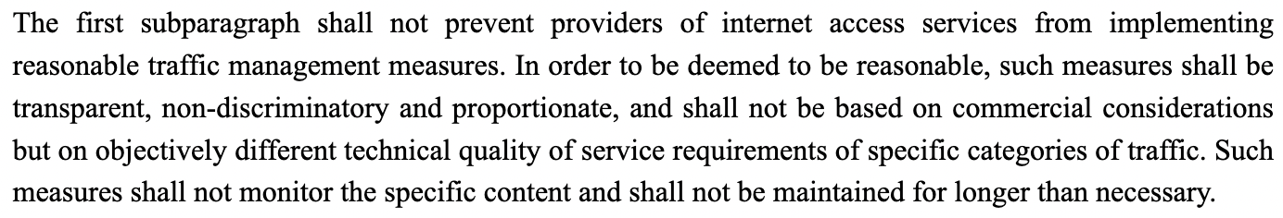
European Union
Net Neutrality Regulation 2015 (No 2015/2120) - Article 3
Notes:
Currently in force and added to by the Telecoms Directive overhaul 2016.
Law varies from country to country.

Slide 3
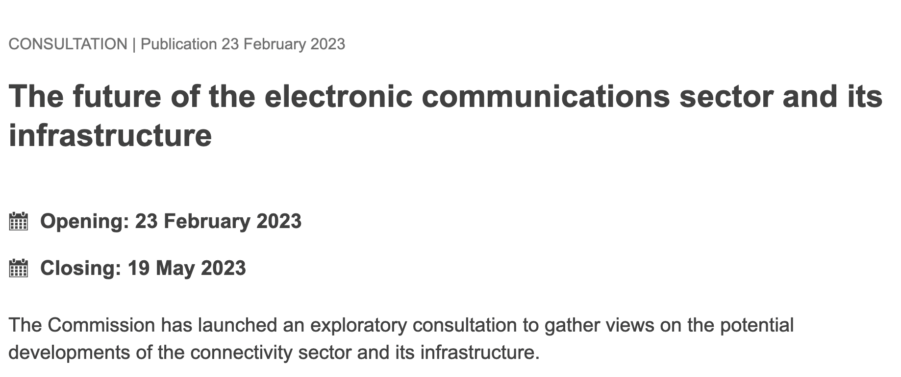

European Commission Consultation
Takeaway 1: We need innovation and efficient investment
Takeaway 2: We need to leverage the Single Market to boost investment and innovation
Takeaway 3: We need to secure our networks
Notes:
https://digital-strategy.ec.europa.eu/en/library/results-exploratory-consultation-future-electronic-communications-sector-and-its-infrastructure
Over and complex regulation in a changed digital environment

Slide 4
United Kingdom
Consultation starting in 2021 (Brexit)
As of October 2023
ISPs can offer premium quality retail offers: gaming or VR etc.
ISPs can develop new ‘specialised services’: traffic management for driverless vehicles, for example
ISPs can use traffic management measures to manage their networks.
Most zero-rating offers will be allowed.
We also clarify that we are unlikely to have concerns where ISPs take reasonable approaches to provide services with clear public benefit. This includes enabling ISPs to prioritise and zero-rate access to emergency services, offer parental controls, manage internet traffic on transport and in public spaces where there is limited capacity available, and prevent access to scam websites and other harmful content.
Notes:
https://www.ofcom.org.uk/__data/assets/pdf_file/0017/270260/Statement-Net-Neutrality-Review.pdf
Latency management

Slide 5
Where does this leave us with latency?
Notes:
Regulation needs updating to take into account new and emerging technologies. In all cases, this should simplification which includes easy to implement law and provide a level (and innovative playing field).

Slide 6
Thank you!
Dominique Lazanski
dml@lastpresslabel.com
dml157@pitt.edu
Notes:
Where does this leave us with Latency?

